Slide 1
YOUR NAME
AIRCRAFT CARRIER EMBARK

Slide 2
Operate with Allies and Partners to maintain a free and open maritime environment
80% of the world’s population lives within 100 miles of a coastline
100% of the time,
the U.S. Navy is deployed around the world
WHY WE NEED A NAVY
The Navy ensures uninterrupted flow of goods and communications
90% of the World’s communications lines pass under the oceans

Slide 3
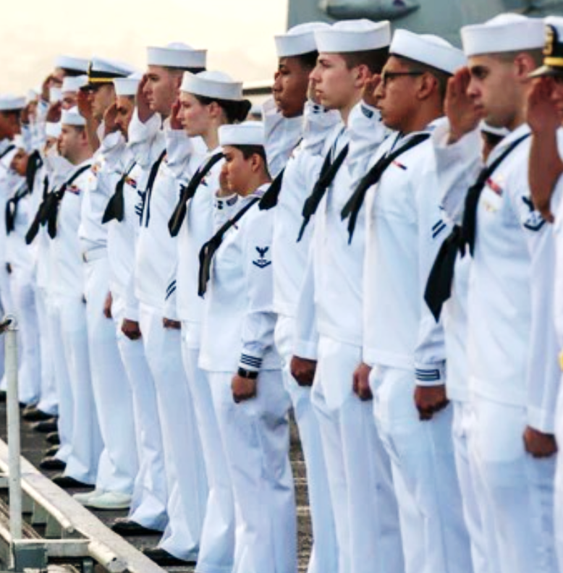
THE U.S. NAVY IS +300,000 STRONG
Officers
Enlisted
(W-1 to O-10)
(E-1 to E-9)
~55,500 Officers. Bachelor’s degree to enter with more opportunities for education during service.
~275,000 Enlisted Sailors. High School grads or greater to join. Specialized careers throughout service.

Slide 4
NAVY SAILORS
Highly Technical Workforce:
•Requires advanced skills
•Formal classroom
•On-the-job training
Ensured Combat Readiness:
•Career progression
•Rotation between deploying and non-deploying jobs
•Persistent training and drilling
•Sailors in today’s Navy are well-educated, highly trained and developed leaders.

Slide 5
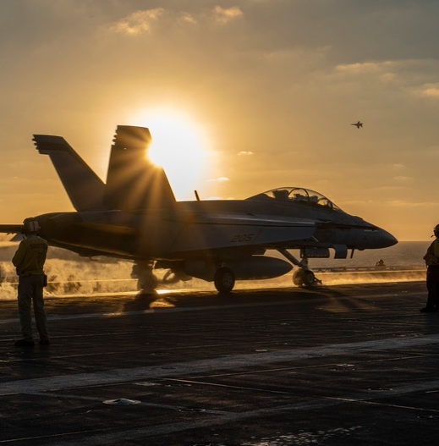
U.S. NAVAL AIR FORCES
Mission
Priorities
People & Platforms
“Man, Train, and Equip, deployable combat-ready Naval Aviation forces that win in combat.”
Warfighting
People
Readiness
100,000+ Sailors
2,806+ Aircraft
145 Squadrons

Slide 6
OUR NAVY’S AIRCRAFT CARRIERS
Nimitz Class
Ford Class
Flight Deck Area: 4.5 acres
Displacement: 97,000 tons
Speed: 30+ knots
Aircraft: 65+
Personnel:
Ship- 2,800
Air Wing- 2,000
Staff- 200
Catapults: 4, steam powered
Flight Deck Area: 4.6 acres
Displacement: 100,000 tons
Speed: 30+ knots
Aircraft: 65+
Personnel:
Ship- 2,440
Air Wing- 2,000
Staff- 200
Catapults: 4, Electromagnetic)
Combat-ready aviation capability: no need to rely on a foreign
nation’s airfield
Sustained high speed enables global transit, sustains maritime superiority, and brings unmatched lethality
On-call global air power can project power ~1,000 miles ashore
No other nation can match U.S. carrier capability

Slide 7
OUR NAVY’S AIRCRAFT
CARRIER BASED
TRAINING
F/A-18 E-F ‘Super Hornet’
EA-18G ‘Growler’
F-35C ‘Lightning II’
E-2D ‘Hawkeye’
C-2A ‘Greyhound’
MH-60R ‘Seahawk’
MH-60S ‘Knighthawk’
T-6B II ‘Texan’
T-44 ‘Pegasus’
T-45 ‘Goshawk’
TH-73A ‘Thrasher”
SHIP/SHORE BASED
CMV-22 ‘Osprey’
MH-53 ‘Sea Dragon’
SHORE BASED
EP-SE ‘Aries II’
P-8 ‘Poseidon’
E-6A/B ‘Mercury’
C-40 ‘Clipper
OPERATIONAL UNMANNED
MQ-8C ‘Fire Scout’
MQ-4C ‘Triton’
MQ-25 ‘Stingray’

Slide 8
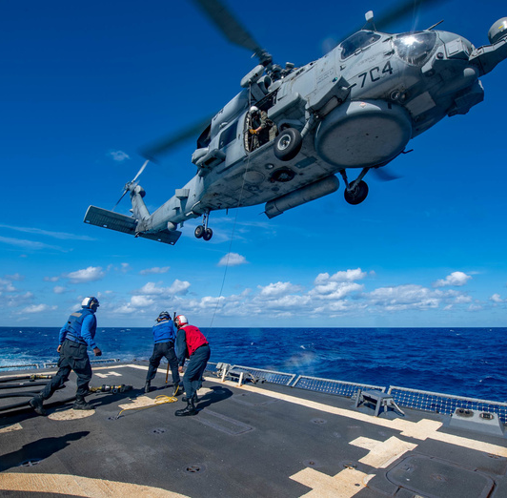
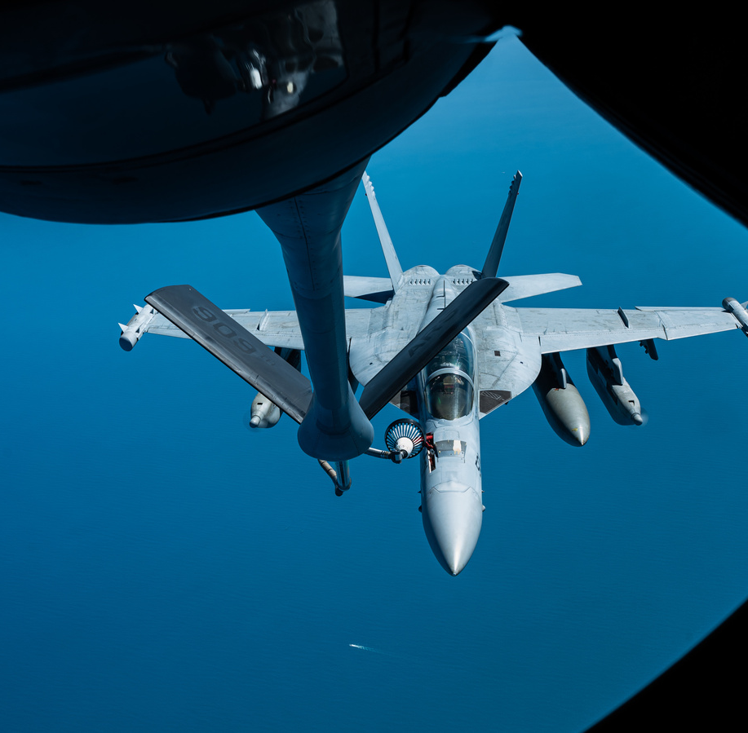
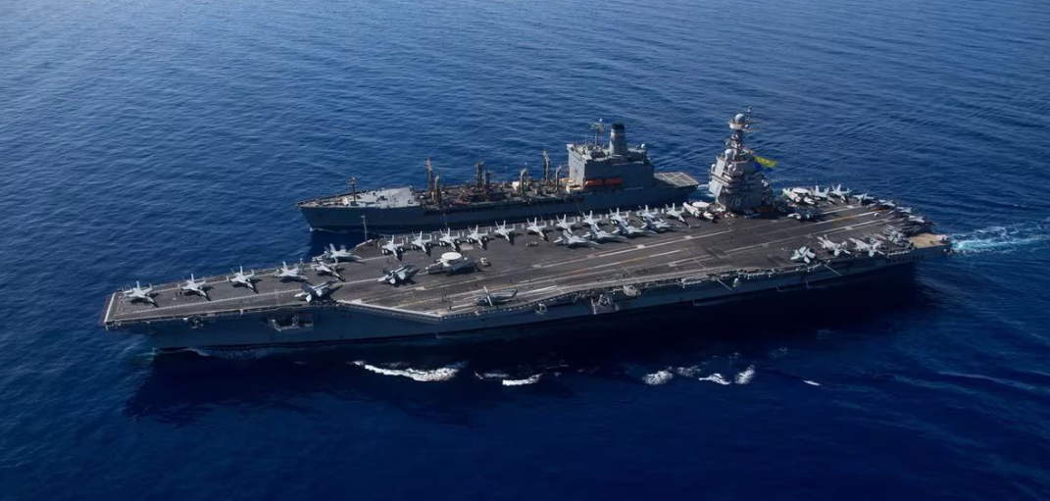
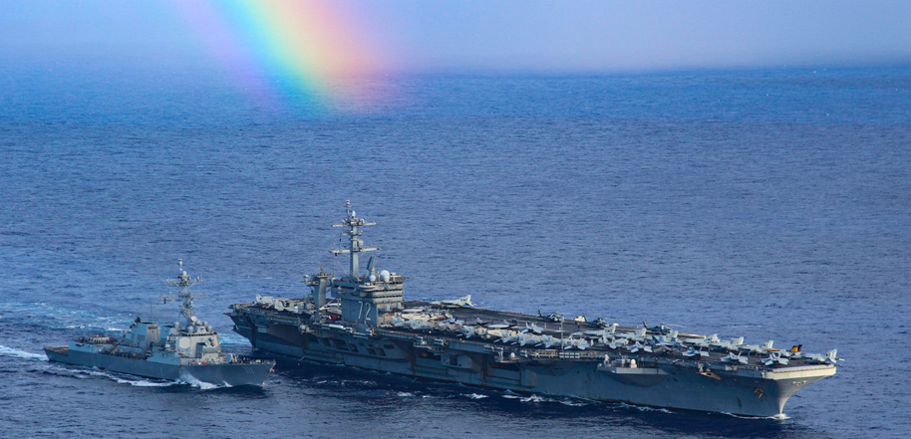
WHY WE DEPLOY
Project power of combat ready Naval forces
Diplomacy in action
Visible presence for allies
Crisis response
Armed response
Humanitarian aide

Slide 9
Your Photo Here
MY EMBARK EXPERIENCE
Landing on Aircraft Carrier
Observe Flight Operations
Flight Deck and Vulture’s Row
Meet the Captain & the Crew
Engage Sailors
Tour the ship
Dining, Coffee & Ship’s Store
Wardroom, CPO & Mess Decks
Berth in 2-person stateroom
Aircraft Departure
Your Photo Here

Slide 10
Naval Air Forces Points of Contact
@U.S. Naval Air Forces
@usnavalairforces
CNAP PAO
CDR Beth Teach
(619) 767-1625
Beth.a.teach.mil@us.navy.mil
CNAL PAO
LCDR Dawn Stankus
(757) 836-4375
dawn.m.stankus.mil@us.navy.mil
SOCIAL MEDIA
CNAP APAO
LTJG Gabe Wahl
(619) 545-4779
Gabriel.j.wahl.mil@us.navy.mil
CNAL DEPUTY PAO
Jennifer Cragg
(757) 836-4388
jennifer.l.cragg1@navy.mil
CNAP DEPUTY PAO
MR. STEVE FIEBING
(619) 767-1622
steven.j.fiebing.civ@us.navy.mil

